Slide 1
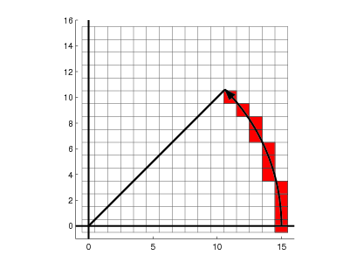
Lecture 3 Properties of a Circle
Circle is symmetric all over, all
points on its circumference lies
equidistant from its centre
coordinates.
Using this property and the
equation of a circle,
f (x_{C}, y_{C})=x_{C}² + y_{C}² - r²
Circle drawing Algorithms can be developed like Midpoint circle drawing algorithm and Bresenham’s Circle drawing Algorithm
*
Ms. Silica Kole CSE BVCOE
‹#›

Slide 2
Mid Point Circle Drawing Algorithm
Step 1: Input the Radius r and centre (x_{C},y_{C}) so first coordinates are (x,y)=(0,r)
Step 2: Calculate the initial value of decision parameter p=1-r
Step 3: if (p<=0), next coordinates are (x+1,y)
new p= old p + 2x(last x)+3
Step 4: if (p>0), next coordinates are (x+1,y-1) and new p=old p+ 2x(last x)-2y(last y)+5
Step 5: Determine symmetry points to the other 7 octants
Step 6: Repeat the above steps till [x(original)<=y(original)]
*
Ms. Silica Kole CSE BVCOE
‹#›

Slide 3
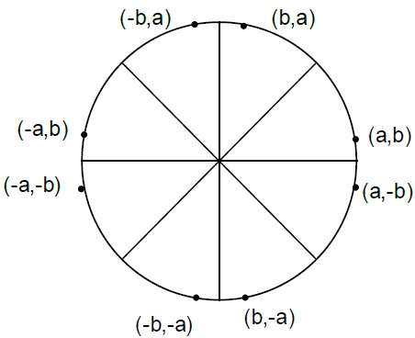
Octants of a circle
*
Ms. Silica Kole CSE BVCOE
‹#›

Slide 4
Bresenham’s Circle Drawing Algorithm
Step 1: Input the Radius r and centre (x_{C},y_{C}) so first coordinates are (x,y)=(0,r)
Step 2: Calculate the initial value of decision parameter p=3-2r
Step 3: if (p<=0), next coordinates are (x+1,y)
new p= old p + 4x(last x)+6
Step 4: if (p>0), next coordinates are (x+1,y-1) and new p=old p+ 4(x-y)last+10
Step 5: Determine symmetry points to the other 7 octants
Step 6: Repeat the above steps till [x(original)<=y(original)]
*
Ms. Silica Kole CSE BVCOE
‹#›

Slide 5
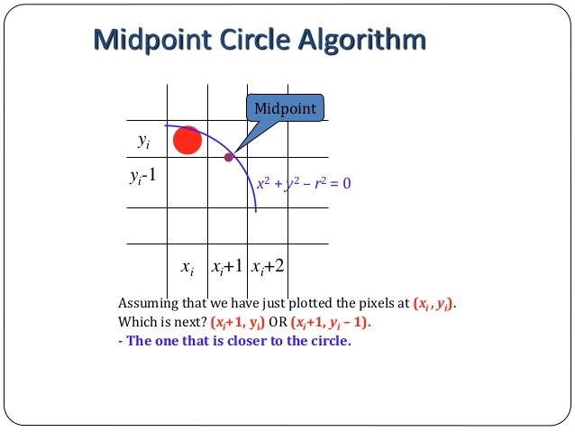
*
Ms. Silica Kole CSE BVCOE
‹#›

Slide 6
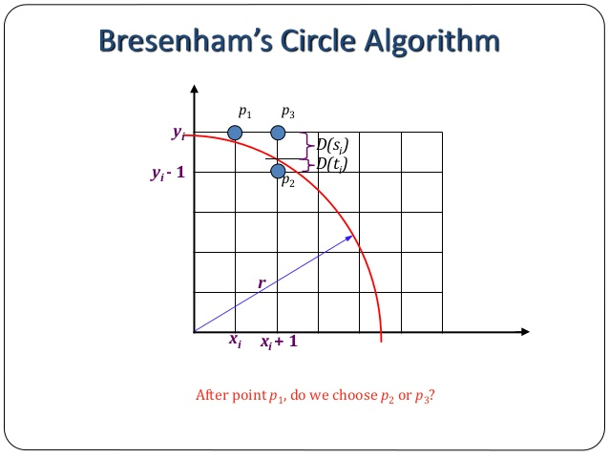
*
Ms. Silica Kole CSE BVCOE
‹#›

